Slide 1
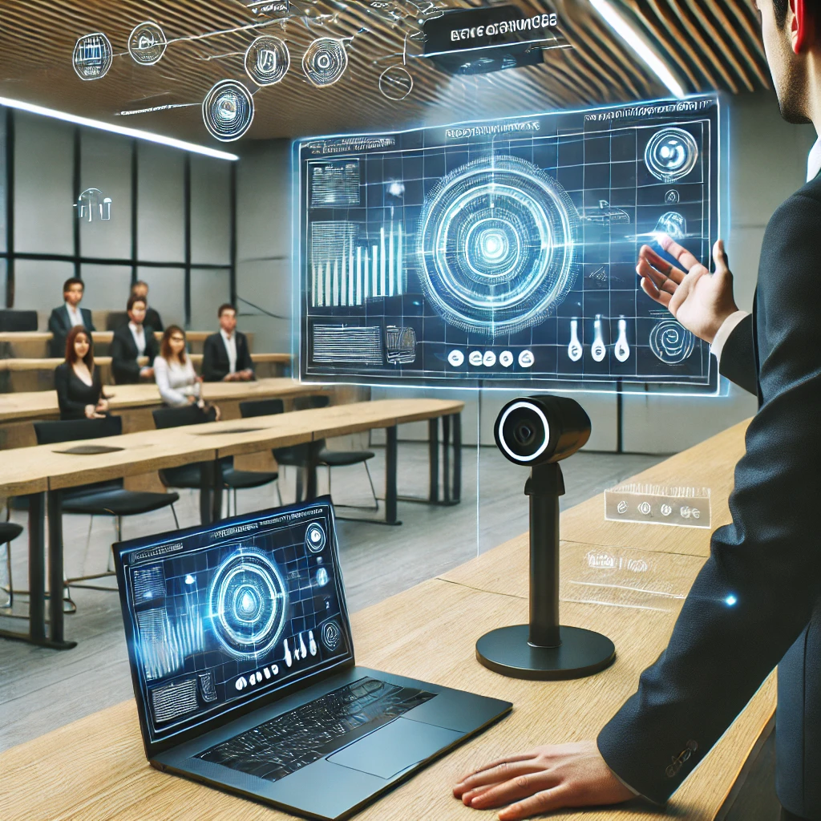
Gesture Controlled Presentation System
Md Rahman - 2103A51057
T Manikanta - 2103A51073 D Vivek - 2103A51088
G Varshith - 2103A51089
K Naveen - 2103A51267
K Raghavendra Chary - 2103A51268
Mentor Name : Gotte Ranjith kumar

Slide 2
Abstract
The system allows users to control a presentation using hand gestures captured through a webcam. It starts by prompting the user to select a folder containing PNG images representing slides.
The program then renames the images sequentially for easier navigation. Once the folder is selected, the webcam captures the user's hand gesture. Hand gestures are interpreted to navigate through slides (swipe left/right), annotate slides (draw), erase annotations, and perform additional commands.
These commands facilitate easy navigation and interaction with the presentation. Annotations can be drawn on slides using specific hand gestures, enhancing interactivity during presentations. The system provides visual feedback by overlaying annotations on the slides in real-time. It also displays the total number of slides and a rectangle indicating the area for gesture recognition.

Slide 3
Introduction
An interactive presentation system that integrates hand gesture recognition to control slides, annotate content, and navigate presentations effortlessly.
We are thinking to build a program where we can control the presentation by our hand gestures.
Our primary aim is to redefine the presentation landscape by offering a dynamic and captivating experience where users can effortlessly navigate slides, annotate content, and execute commands with natural hand gestures.
We can define the gestures dynamically so that we can perform the operations in the presentation like to move to the next slide and previous slide.
We can also write and delete on the slides. We can even point out the features or content on the slide that we are explaining only by using hand gestures.

Slide 4
Problem Statement
Traditional presentation control methods require physical devices. This system replaces these with intuitive hand gestures, enhancing mobility and engagement.
Most of the people while giving presentation they are using highlighters or digital pen to write the things. People are using remotes to move the slides instead of that we can just control the presentation by hand gestures.
This innovative application seeks to replace conventional tools like highlighters and digital pens with intuitive hand gestures, offering presenters greater mobility and interaction capabilities.
The ultimate goal is to redefine the presentation experience by providing a cohesive and intuitive system that enhances interaction dynamics and eliminates the need for traditional tools.

Slide 5
Literature Review
Paper Title | Authors | Institution | Methodology | Key Contributions | Challenges Mentioned
Gesture Recognition in HCI | Devivara Prasad, Mr. Srinivasulu M | UBDT College of Engineering, India | Machine Learning, MediaPipe, OpenCV | Presentation control for hearing-impaired and stroke patients | Accuracy, robustness
Hand Gesture Recognition for HCI | G. Reethika, P. Anuhya, M. Bhargavi | JNTU, Sreenidhi Institute of Science and Technology, Hyderabad, India | Vision-based techniques using cameras | Potential replacement for traditional input methods | Computational intensity, privacy concerns
Smart Presentation Control by Hand Gestures | Hajeera Khanum, Dr. Pramod H | Rajeev Institute of Technology, Hassan, Indi | OpenCV, MediaPipe, webcam-based gesture recognition | Slide control, drawing, and erasing via gestures | Lighting conditions, reliability
Automated Digital Presentation Control Using Hand Gesture Technique | Salonee Powar, Shweta Kadam, Sonali Malage, Priyanka Shingane | Unspecified | OpenCV, MediaPipe, AI-based gesture recognition | Hands-free slide transitions, video pausing, volume control | Not explicitly mentioned
Hand Gesture-Based Interactive Presentation System Utilizing Heterogeneous Cameras | Bobo Zeng, Guijin Wang, Xinggang Lin | Unspecified | Thermal camera for segmentation, web camera for calibration | Robust recognition in complex backgrounds | Precise calibration, hand localization
Smart Presentation Using Gesture Recognition | Meera Paulson, Nathasha P R, Silpa Davis, Soumya Varma | Unspecified | ATMEGA 328, Python, Arduino, Zigbee, wireless transmission | Presentation control, home automation, sign language interpretation | Not explicitly mentioned

Slide 6
Proposed Approach
1. Data Collection and Preprocessing:
Input: PNG Images of PowerPoint slides
Data Collection: Gather PowerPoint slides and convert them into PNG image format.
Data Preprocessing: Organize the PNG images in a folder in sequential order for easy retrieval and usage during presentations.
2. Building the Hand Gesture Recognition:
Programming Language: Python
Libraries:
Os: Operating System.
Re: Regular Expression.
OpenCV (cv2): For computer vision tasks, including image processing, detection, and tracking.
NumPy: For numerical operations and array manipulations.
Custom HandTrackingModule: A module for hand detection, finger tracking, and gesture recognition. Likely built using machine learning or custom algorithms.

Slide 7
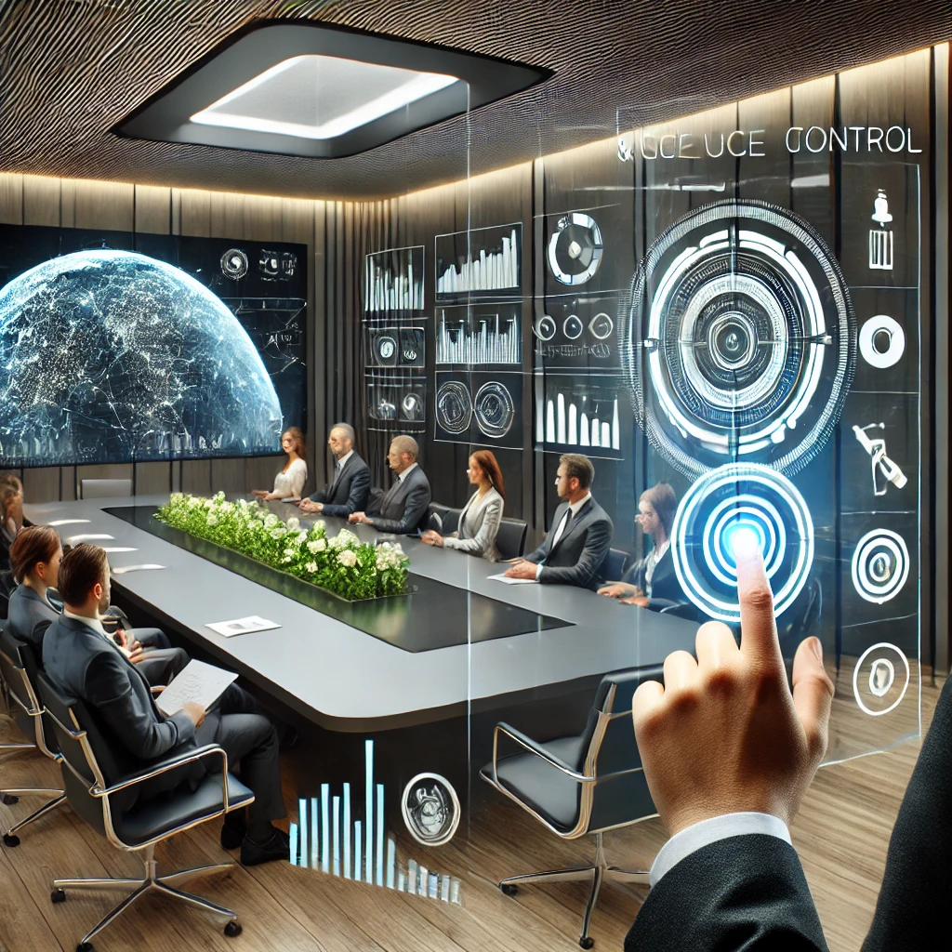
Implementation & Results
- Implemented using Python, OpenCV.
- Achieved an accuracy of 80-90% for gesture recognition
- Real-time interaction with minimal lag
Trigger actions such as next slide, previous slide, write/draw, delete, pointer, and exit/terminate presentation based on recognized gestures.

Slide 8
Challenges & Conclusion
Challenges:
- Varying lighting conditions impacting gesture tracking
Conclusion:
- Provides a hands-free interactive presentation experience
- Enhances engagement with gesture-based.
In conclusion, while the presented system demonstrates the potential of hand gesture for interactive presentations, there are opportunities for refinement and enhancement.

